Slide 1
SLOVAKIA
PRESENTATION FOR QUIZ

Slide 2
DEMITRA
Pavol Demitra (29 November 1974 – 7 September 2011) was a Slovak professional ice hockey player.
He played sixteen seasons in the NHL and one in KHL.
The 2011 Lokomotiv Yaroslavl plane crash occurred on 7 September 2011, when a Yakovlev Yak-42 passenger aircraft.
Carrying the entire hockey team of Lokomotiv Yaroslavl of the Kontinental Hockey League (KHL).
Plane crashed near Yaroslavl, Russia, on its way to Minsk, Belarus, to start the 2011–12 KHL season.
His play number was 38 and now any ice-hockey player can´t take it. He played lot of representational events as captain of the Slovak team.
Last match for us played 9 May 2011 versus Denmark (4-1).

Slide 3
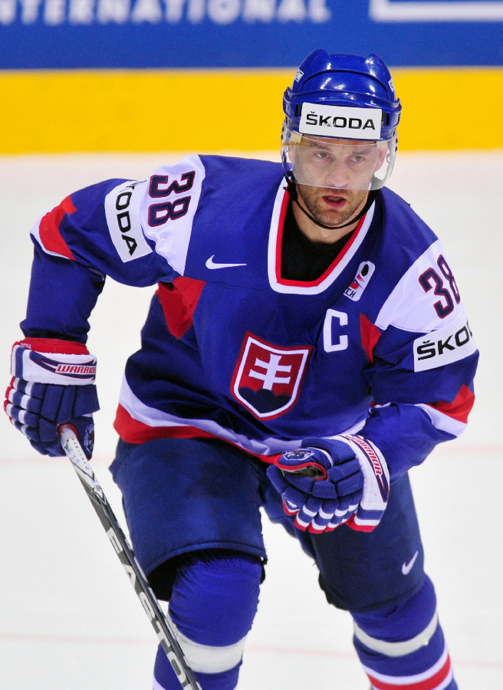
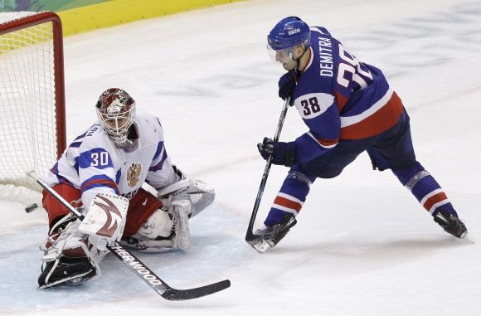

Slide 4
FUJARA
The fujara is a Slovak folk woodwinds. It is similar to a Gothic three-hole bass flute, which were well known and widely distributed in Europe in the 12th - 13 century.
According to experts, the Slovak fujara, instead of fujara comes in north Banská Bystrica, Slovak. Fujara was used by for herding sheep herders and also in various ceremonial It was used as a signal communication tool. Area using the area fujara Podpoľanie. Her melodious sound of music used in its creation and Slovak composers. Fujara and fujarovú music included by UNESCO since 2005 on the UNESCO World Oral and Intangible Cultural Heritage of Humanity

Slide 5
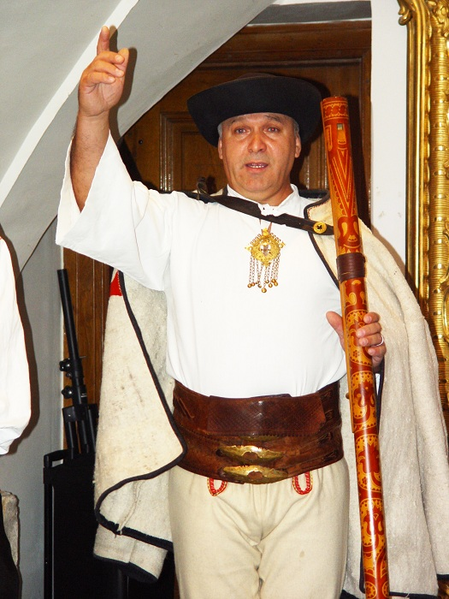
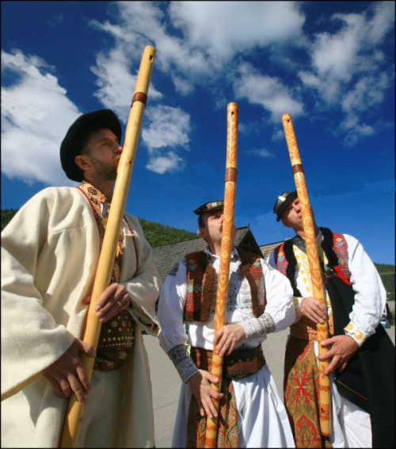

Slide 6
BRYNDZA
Bryndza is a sheep milk cheese made in Poland, Slovakia and Ukraine.Recipes differ slightly across the countries.
Liptov sheep cheese is packaged in traditional wooden barrels.
Sheep cheese with steamed today is one of the traditional Slovak cheese products and has the status of a protected product. It is an essential element in a typical Slovak meals in sheep cheese, also in traditional soup Demikát.

Slide 7
